Slide 1

In Motion:
Power Up with Physical Activity
From the American Heart Association
Locally Sponsored by

Slide 2
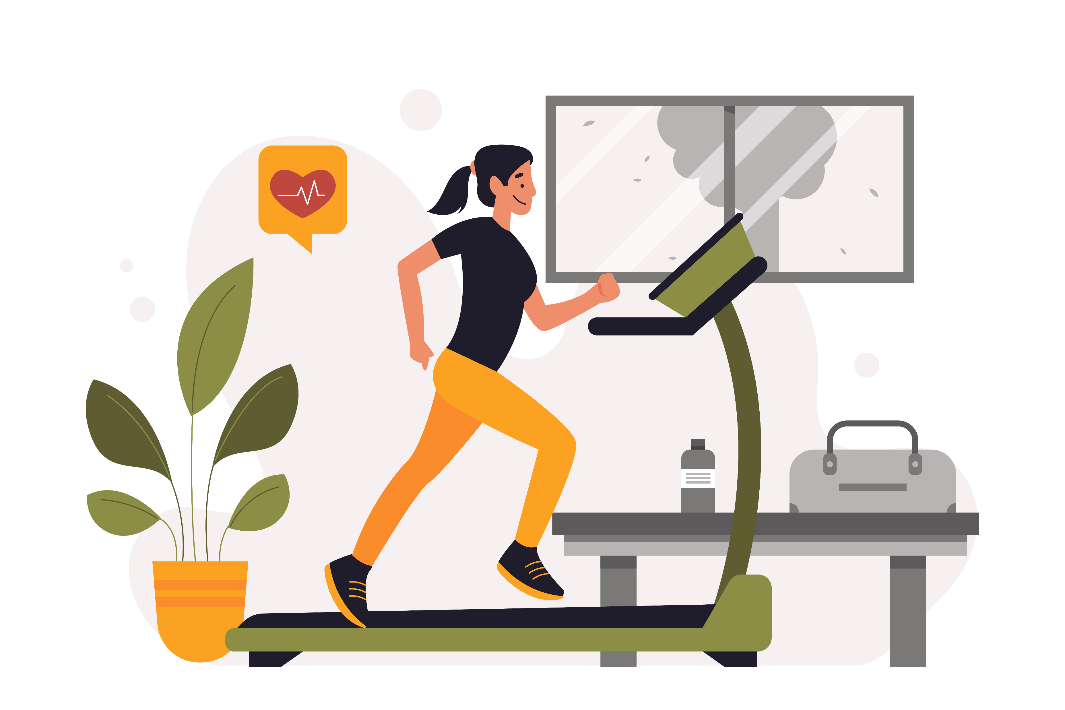
Why Physical Activity Matters
Exercise is a workout for your heart and your brain – it reduces your risk for cardiovascular disease.
It also can reduce stress, improve your mood and help you feel recharged.
Notes:
SOURCE
https://www.heart.org/en/healthy-living/healthy-lifestyle/lifes-essential-8/how-to-be-more-active-fact-sheet

Slide 3
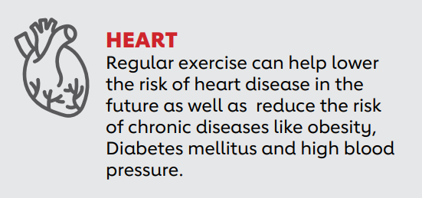
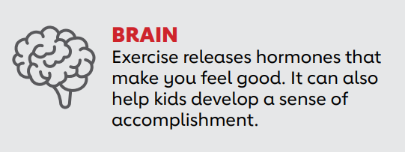
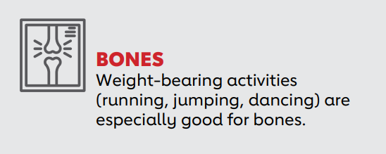
Physical Activity Helps Our…
Notes:
SOURCE
https://www.heart.org/-/media/Healthy-Living-Files/LE8-Fact-Sheets/For-Kids/lifes_essential_8__for_kids_in_motion.pdf?sc_lang=en

Slide 4
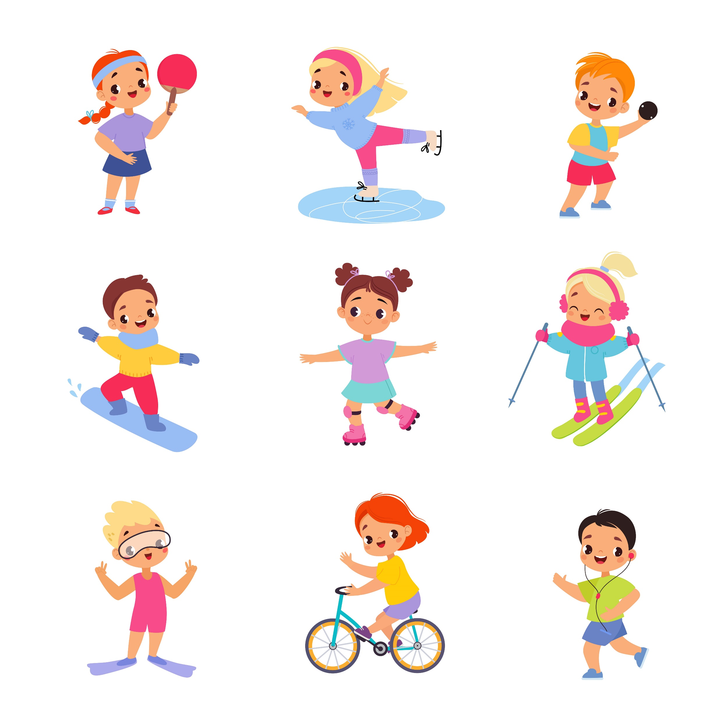
How Much Physical Activity Do Kids Need?
Improving and maintaining cardiovascular health should start early!
Children 3-5 years old should be physically active and have plenty of opportunities to move throughout the day.
Kids 6-17 years old should get at least 60 minutes per day of moderate- to vigorous-intensity physical activity, mostly aerobic.
Notes:
SOURCE
https://www.heart.org/en/healthy-living/fitness/fitness-basics/aha-recs-for-physical-activity-in-adults

Slide 5


How to Talk to Kids About Physical Activity
Physical activity, or exercise, is like a superpower for our bodies. It makes us strong, helps us grow, and keeps us healthy.
Just like superheroes have special powers, exercise gives
our bodies energy and helps us feel our best.
When we play, run, jump, and move our bodies, it’s like giving them a special workout. Physical activity makes our hearts stronger, just like doing exercises can make our
muscles stronger.
Notes:
SOURCE
https://www.heart.org/-/media/Healthy-Living-Files/LE8-Fact-Sheets/For-Kids/lifes_essential_8__for_kids_in_motion.pdf?sc_lang=en

Slide 6
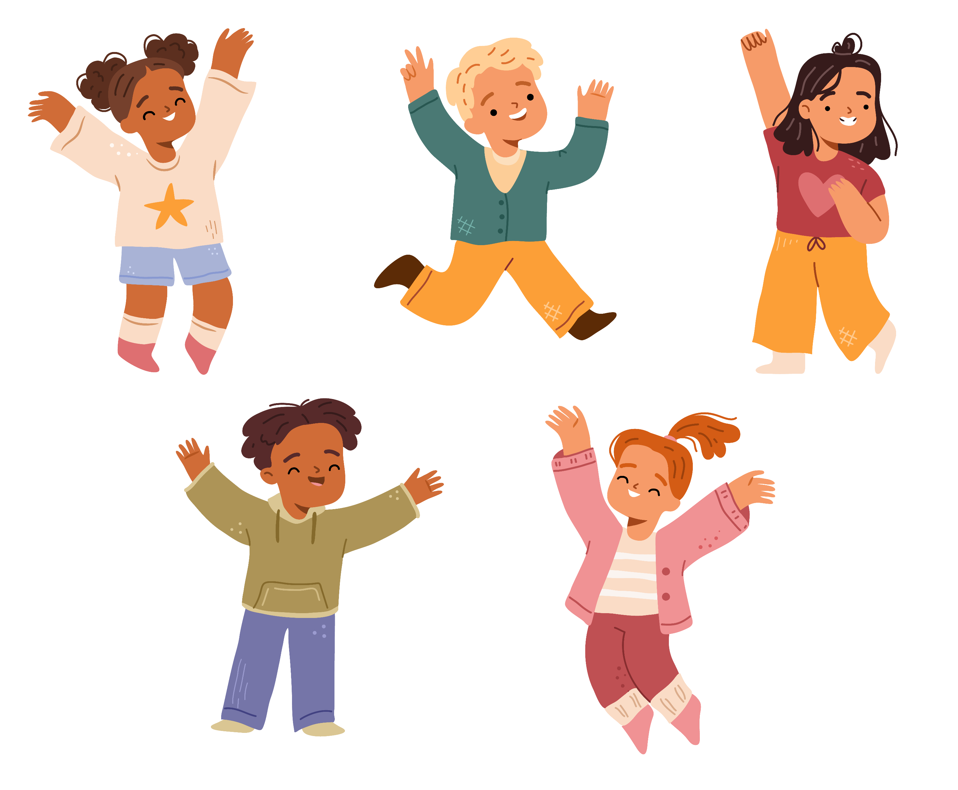
Finding Balance
Being physically active is not just about being strong or winning races. It’s about feeling good and having fun too!
The important thing is to find activities that kids enjoy and that you can do together – and make them a regular part of your day.
Notes:
SOURCE
https://www.heart.org/-/media/Healthy-Living-Files/LE8-Fact-Sheets/For-Kids/lifes_essential_8__for_kids_in_motion.pdf?sc_lang=en

Slide 7




Tips for Getting Active Together
POWER UP
YOUR WALK
There are countless ways to make a typical neighborhood walk more fun. Make it a scavenger hunt or nature walk. Along the way, use what’s available to add in other exercises - a park bench is a great place to do elevated pushups or a curb to do step-ups.
PLAY YOUR FAVORITE GAMES
Your kids may enjoy playing the games you loved as a kid. Old-school favorites such as tag, hopscotch or musical chairs get the heart rate and giggles going.
CREATE AN OBSTACLE COURSE
Create a backyard obstacle course with everyday items. Jump over a branch, crawl under a table, lunge from one tree to the next. How many other obstacles can you and your kids create?
TURN ON
THE MUSIC
Dancing is free and can be done almost anywhere. Play some of your childhood favorite songs or pick a theme and dance to the music of another culture.
Notes:
SOURCE
https://www.goredforwomen.org/en/mom-life/for-moms-with-elementary-age-kids/moving-with-your-kids-can-be-fun-and-healthy

Slide 8
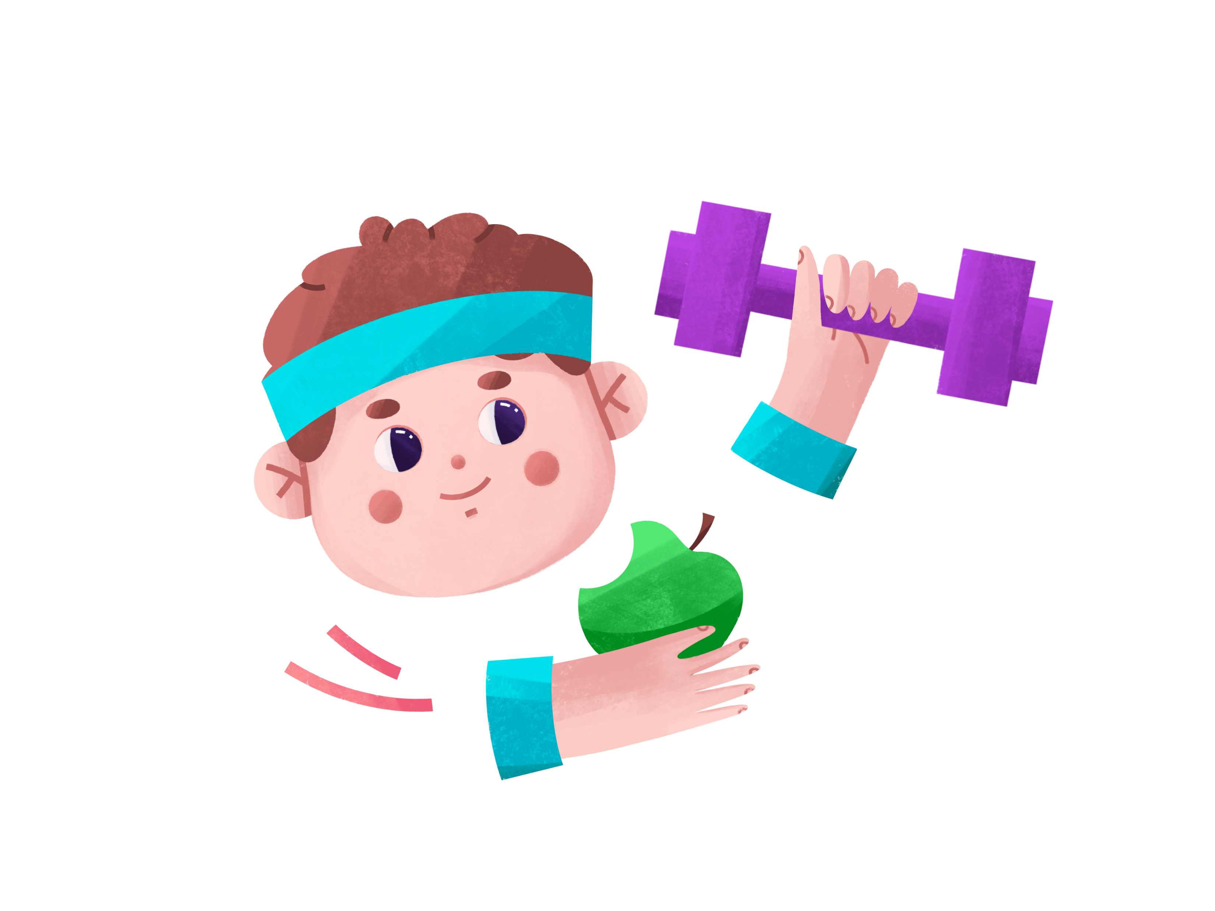
Keep the Motivation Strong
Explore Parks and New Activities – Venture out of your usual surroundings and try new locations to get active. Local parks, businesses, and rec centers may have free or low-cost options that keep things exciting.
Chart Your Progress – A family calendar where you log your activities can be motivating for you and your kids to see the progress!
Notes:
SOURCE
https://www.goredforwomen.org/en/mom-life/for-moms-with-elementary-age-kids/moving-with-your-kids-can-be-fun-and-healthy

Slide 9

Better Together
Ask others to join you: Team up with other parents, friends or neighbors and have fun as a group with games such as kickball or volleyball.
Include furry friends: Dogs can be “purrfect” motivators to keep the family moving. Take the dog on a walk, visit a dog park or play together in the backyard.
Notes:
SOURCE
https://www.goredforwomen.org/en/mom-life/for-moms-with-elementary-age-kids/moving-with-your-kids-can-be-fun-and-healthy

Slide 10
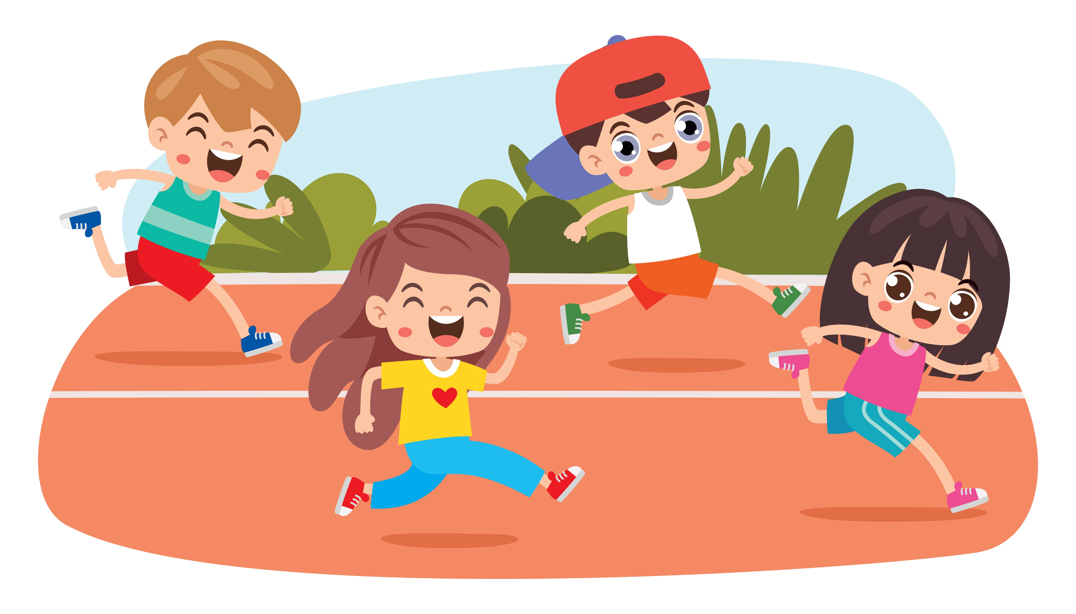
Wrap Up
Active kids create healthier adults!
Physical activity reduces risk of cardiovascular disease AND its risk factors like obesity, diabetes and high blood pressure.
Find activities you enjoy doing together – and make them a habit!

